Slide 1
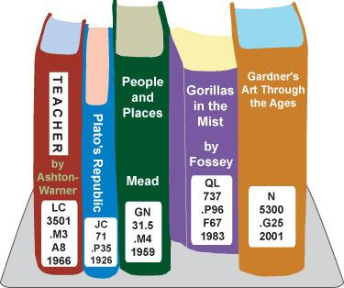
Library MAP
APPLICATION
Lee Miller, Hui Li, Andrew Smith, Linna Chen

Slide 2
BUSINESS CONTEXT AND GOALS
The library originally had a web application that maps catalogued books into various shelves based on the book’s call number. We were asked to turn all book and shelf locations into data that library staffs would be able to edit on an administrative page. Using the data, the shelves should be able to appear dynamically on the map, instead of having each shelf hard-coded in the html code.
The goal of library project application is to create an admin dashboard primarily for library staffs to manage sets of records in the database via web forms and also be able to visualize feedback results left by application users.

Slide 3
Technical requirements
Mobile friendly web application
CRUD database management system using server side scripting language such as PHP
Login system for library staffs
Use charts as ways to visualize data

Slide 4



RELATED TECHNOLOGIES

Slide 5
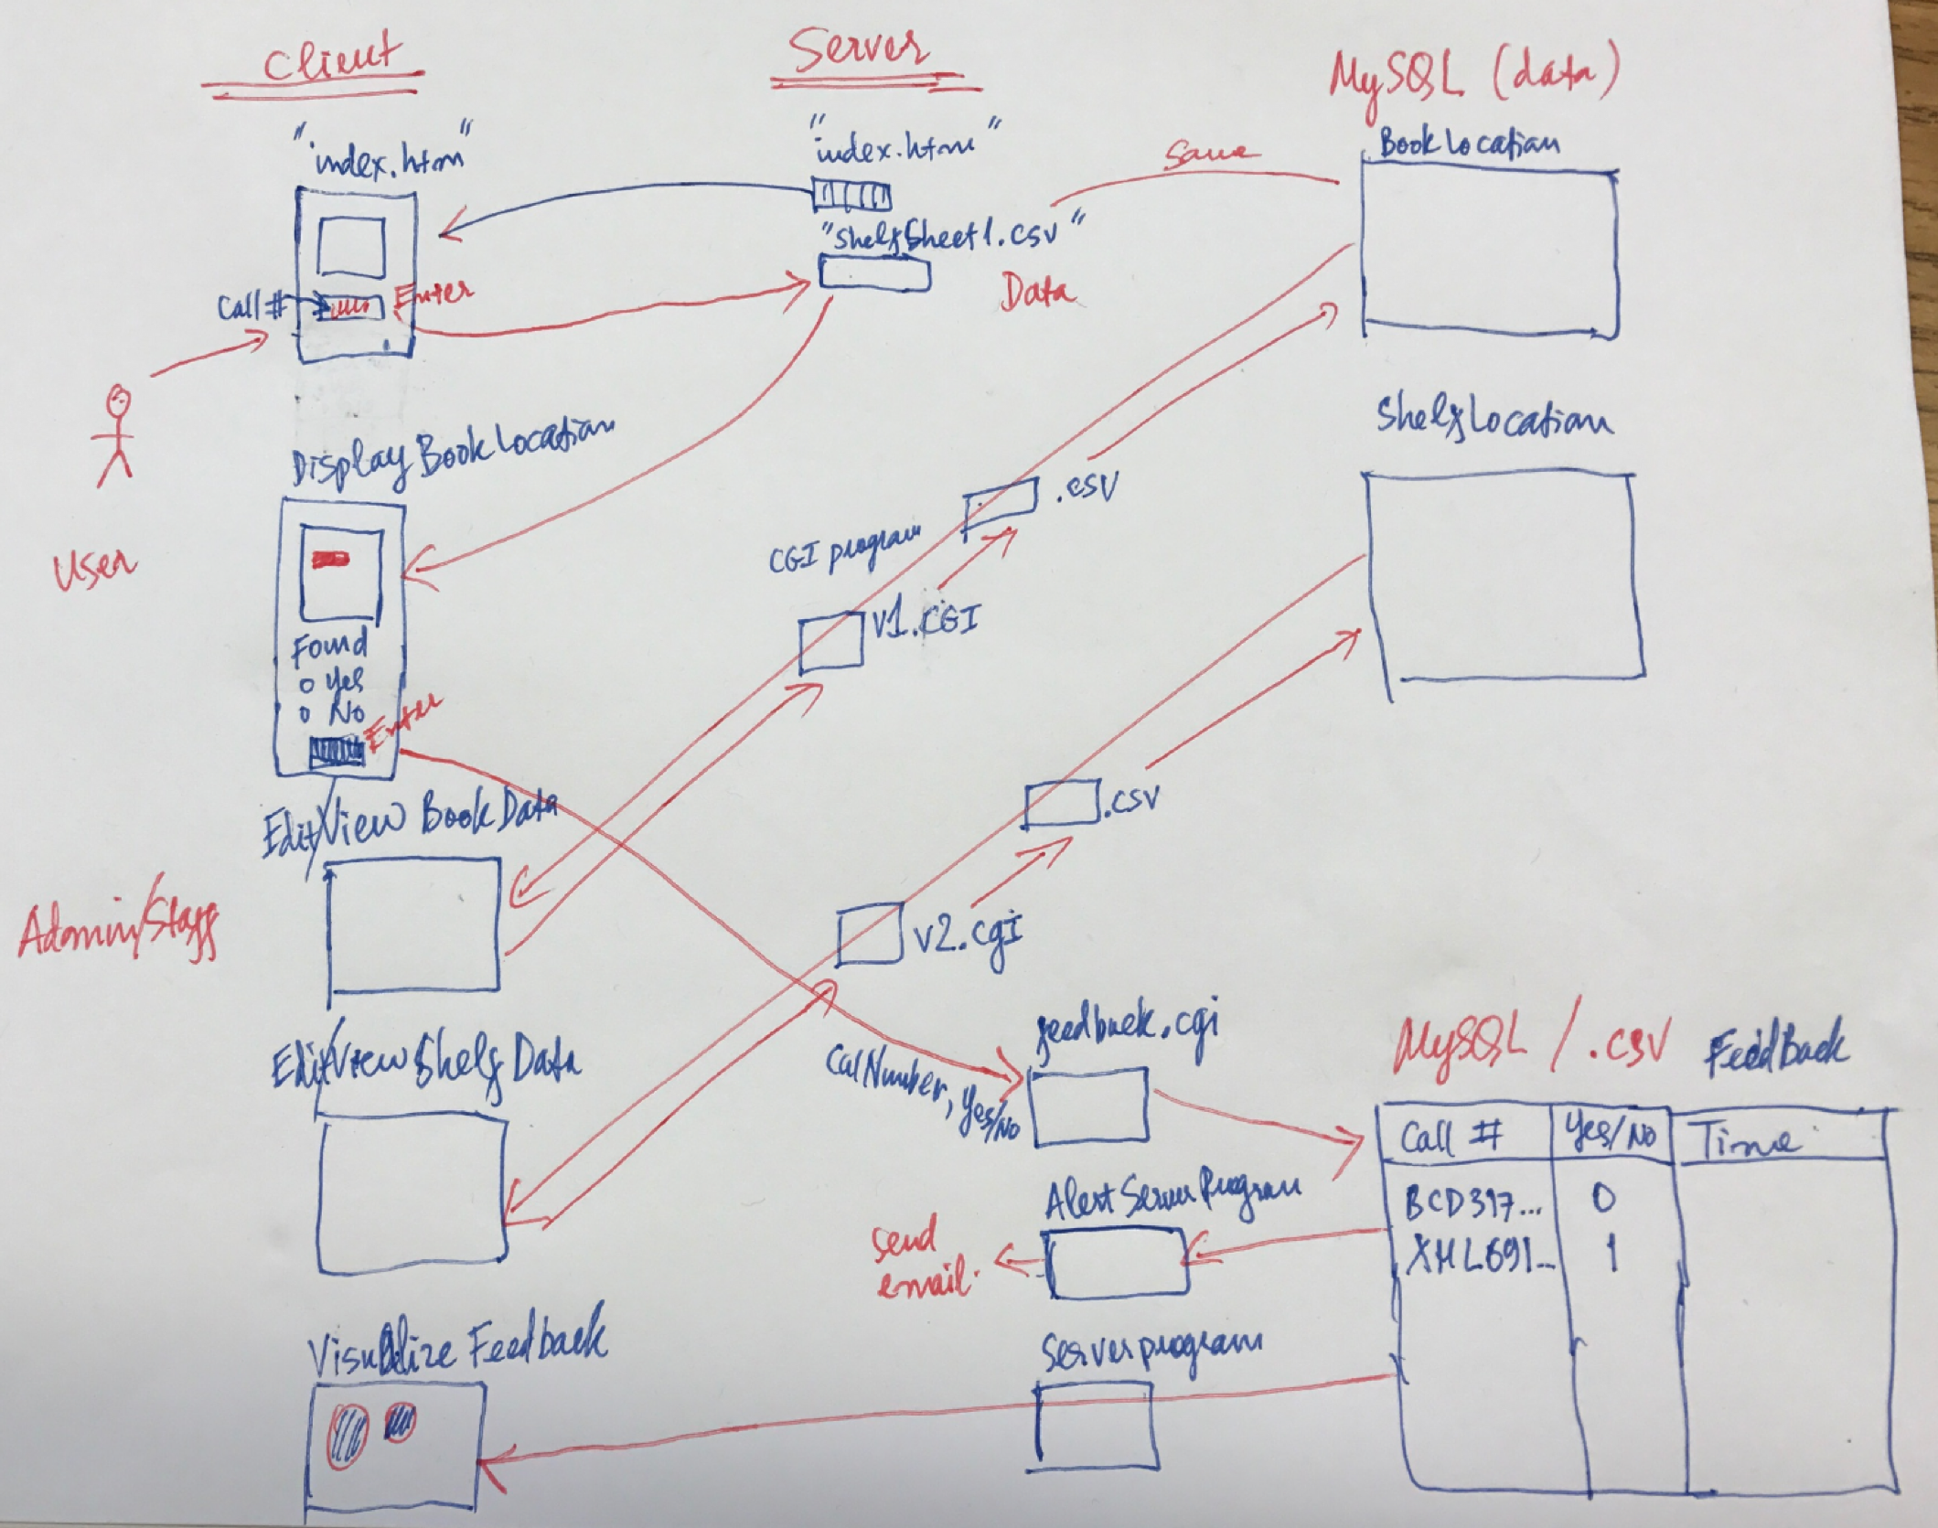
SYSTEM ARCHITECTURE

Slide 6
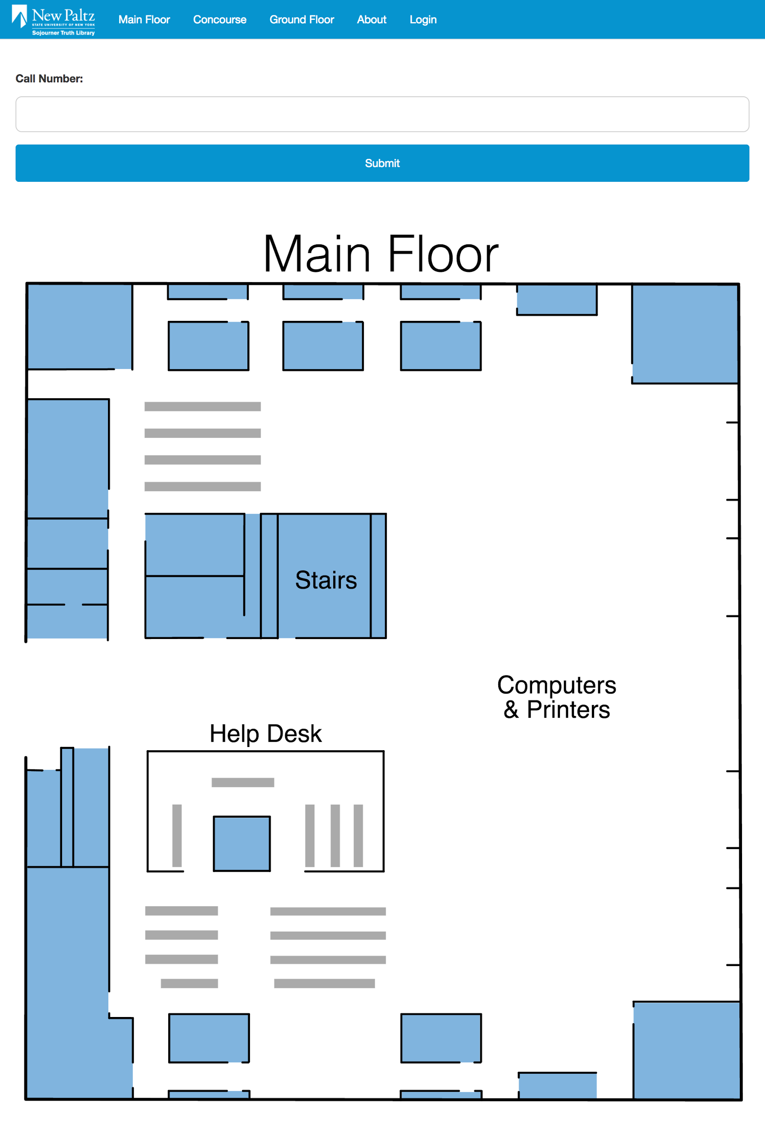
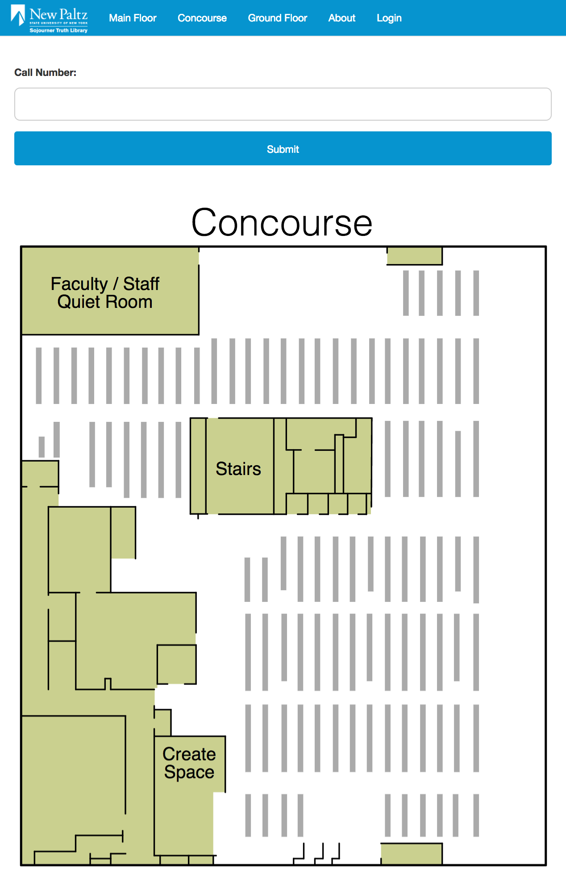
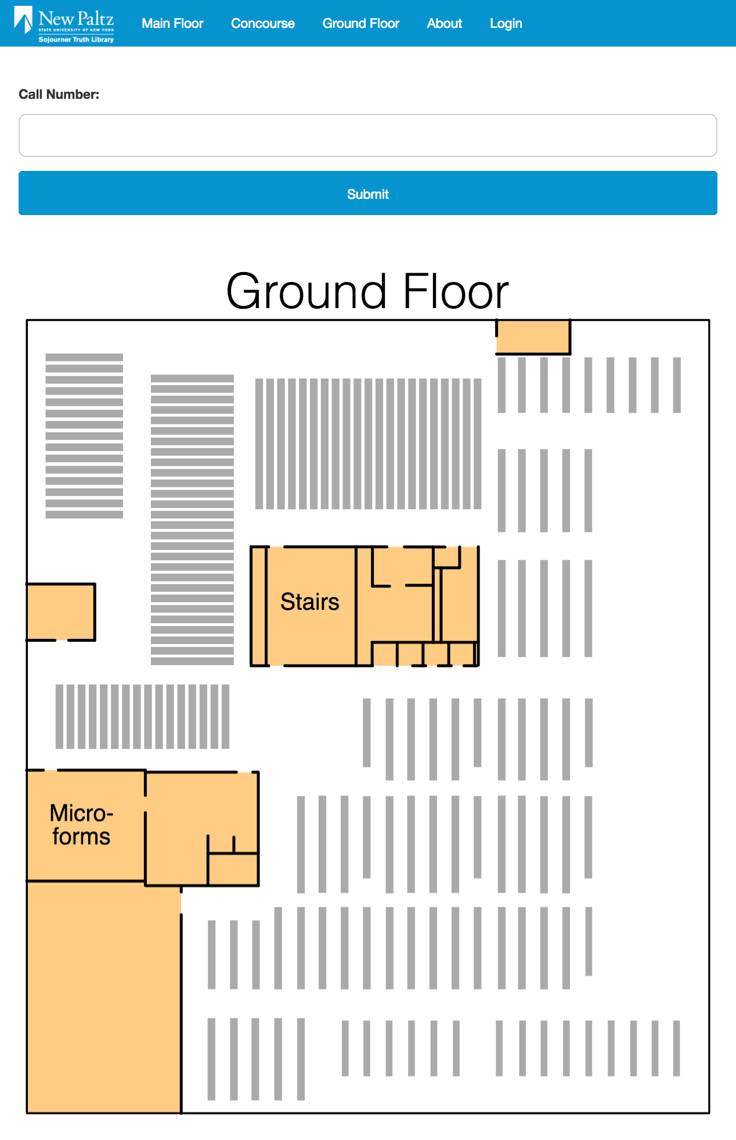
COMPONENTS
Search box for call numbers
Maps of each floor

Slide 7
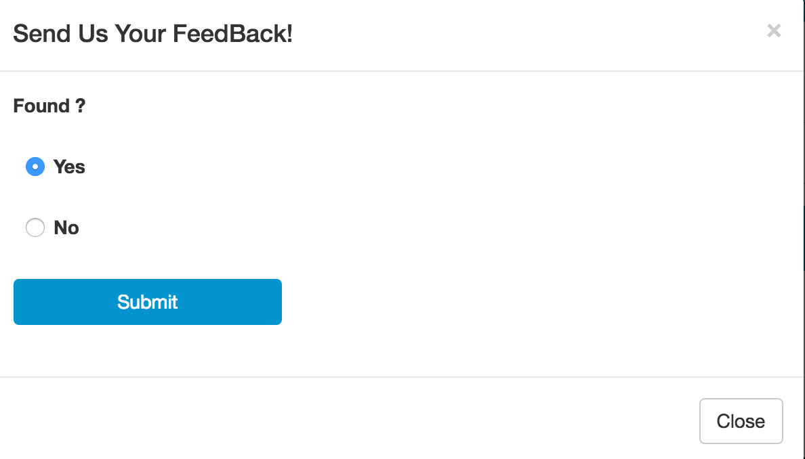
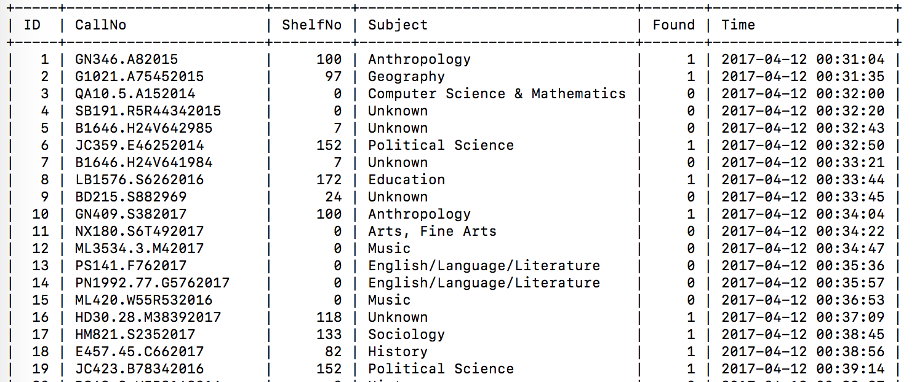
COMPONENTS
Send feedback module
Once feedback is sent, the call number will be entered into the database along with the subject and shelf number associated with it.

Slide 8
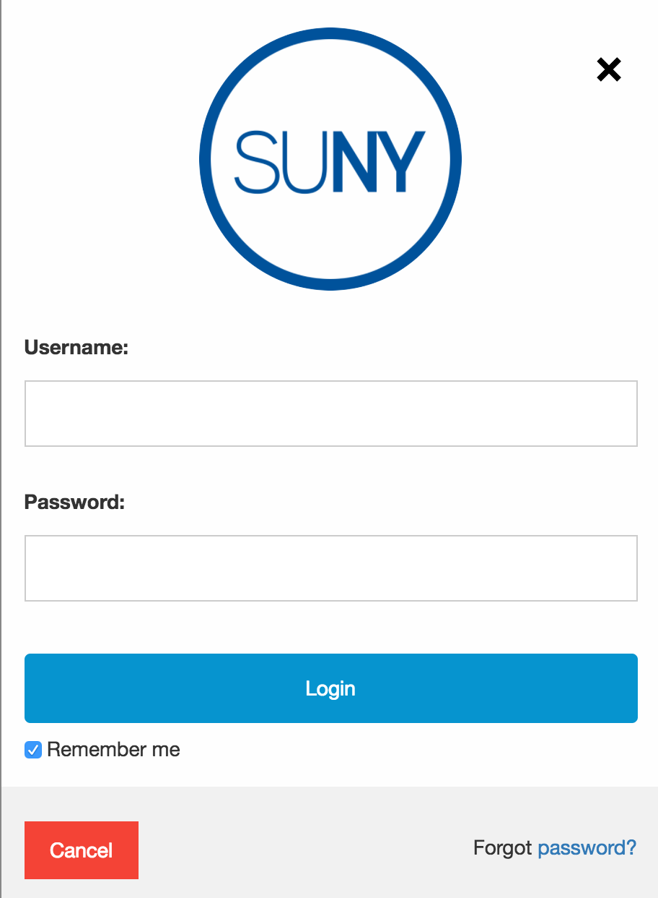

COMPONENTS
Login module
Administration panel

Slide 9
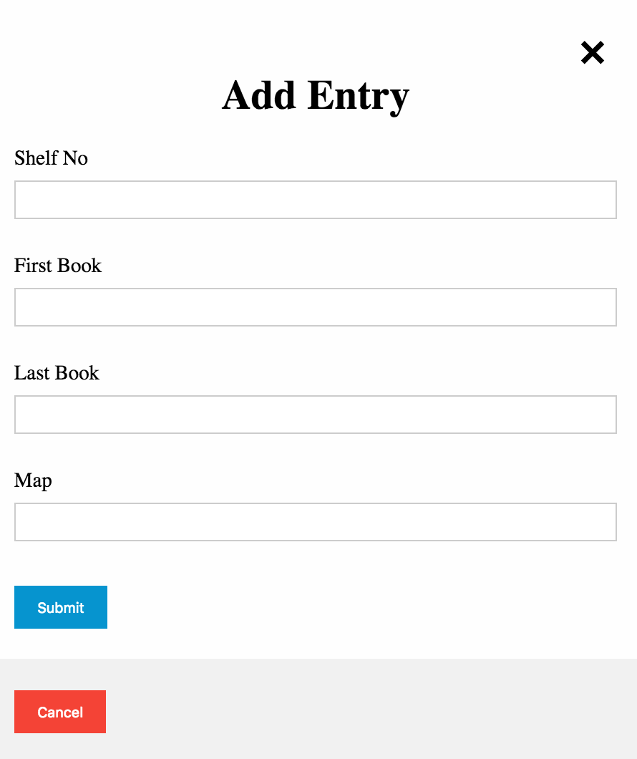
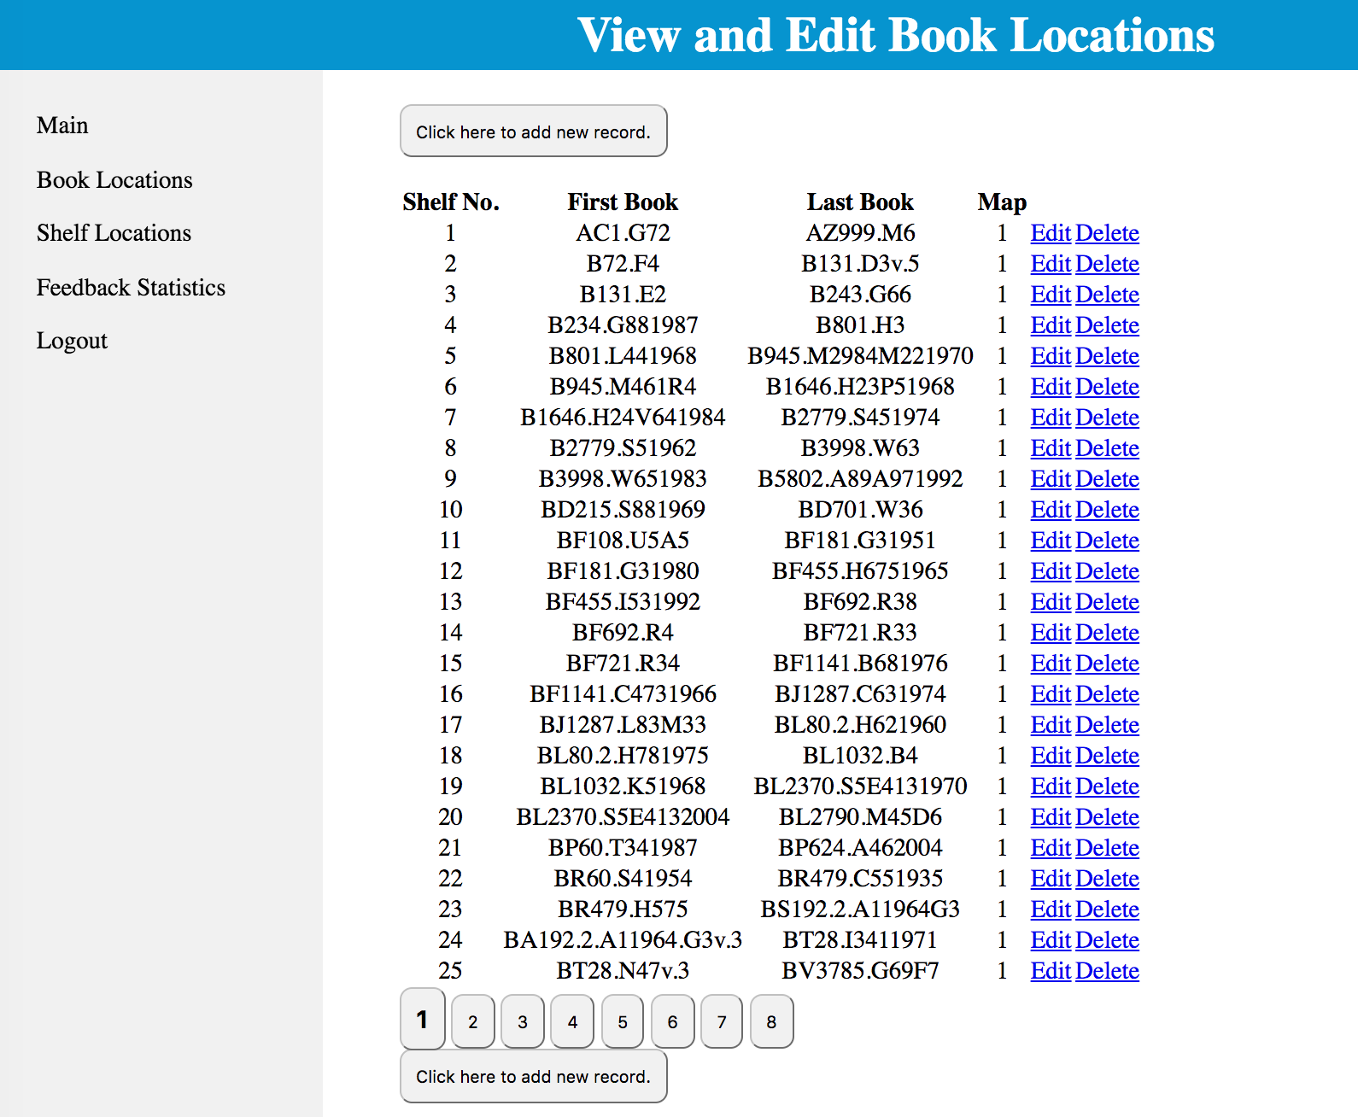
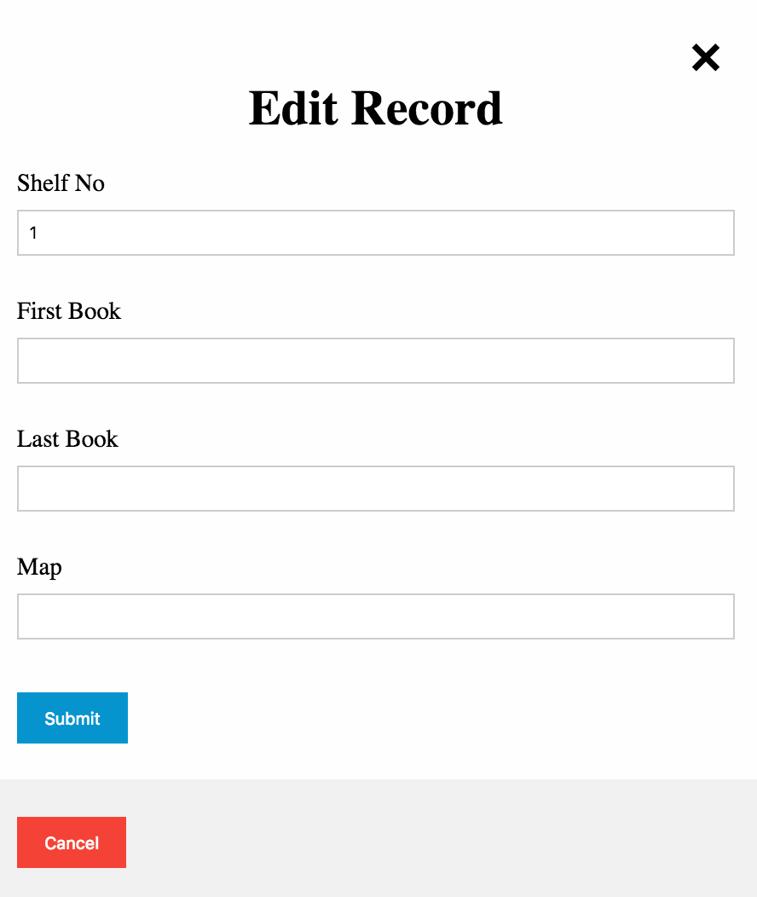
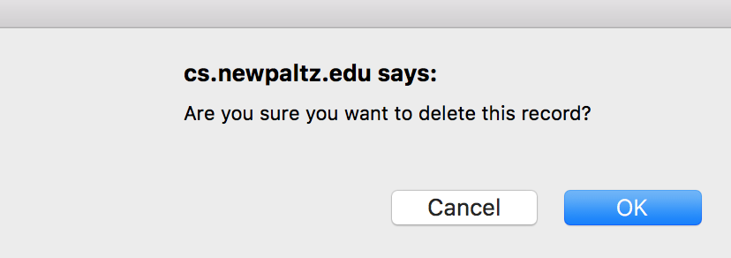
COMPONENTS
CRUD database management system

Slide 10
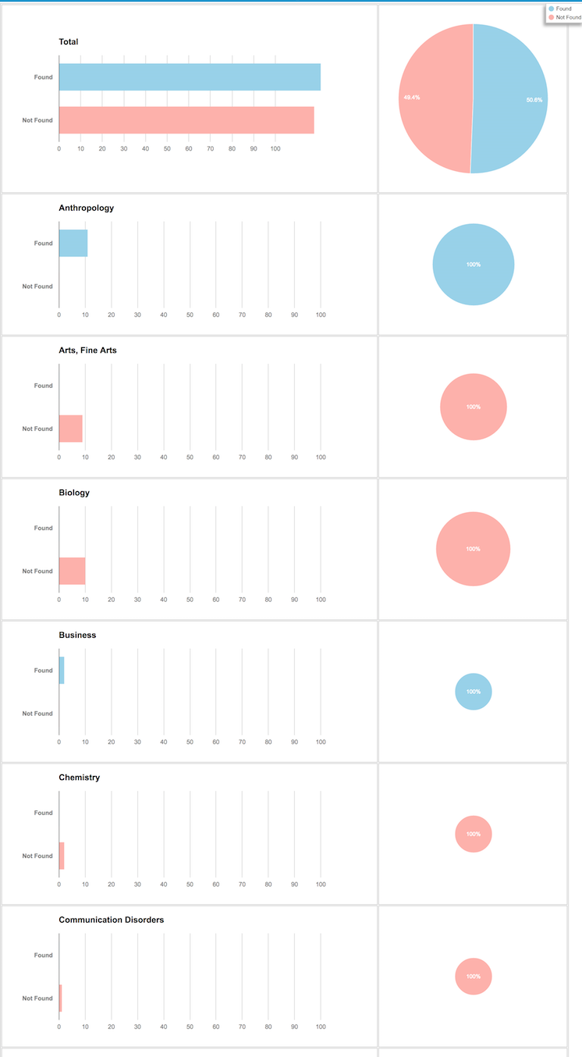
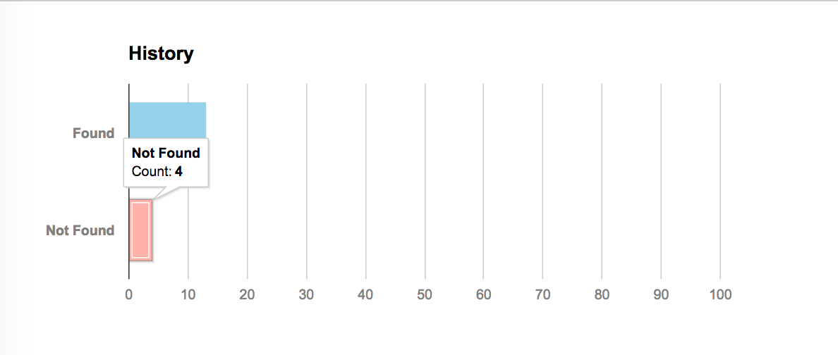
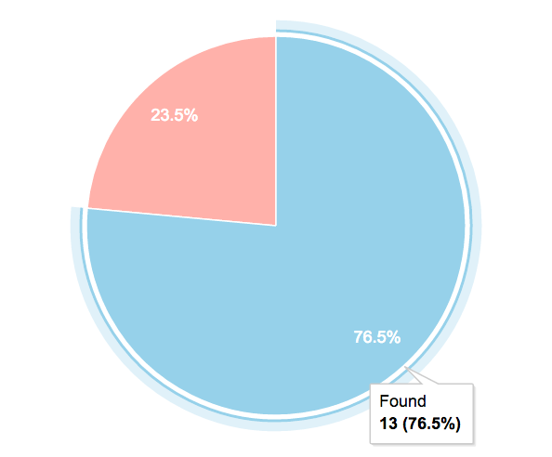
COMPONENTS
Data visualization

Slide 11
SOFTWARE/SYSTEM DESCRIPTION
Library Map Application allows a user to search a book’s location within the library shelves. The application starts by receiving a call number entered by the user. The application then finds the shelf number of the shelf containing book. It does this by finding the shelf with a range of call numbers that the user entered call number resides in. The application then colors the correct shelf on the map and then sends feedback based on subject, found or not found, etc.

Slide 12
TEST RESULTS/OBSERVATIONS
We began testing by feeding several real call numbers as well as fake ones into the application. We observed how it logged the feedback ad well as whether it colored the correct shelf or not. We found the application to be running as expected. We also tested the functionality of the MySQL database tables to ensure that the data was added correctly. The functionality of the newly designed admin page was also tested and proved to function as expected.

Slide 13

PROFESSIONAL AND CAREER BENEFITS
The Library Map Application has many professional and career benefits. The Sojourner Truth Library Administration hopes to present the application to other SUNY library administrators. In addition, to use by other SUNY campuses, the application can be implemented for use in other private libraries. The application allows for smoother locating of books within a library. The Library Map Application streamlines the book locating process for the user.

Slide 14
CONCLUSION
For the Library Map Application, we started with a previous version of the application by a previous developer. From there, we redesigned the map to make it more dynamic by creating separate layers for the map backgrounds, selves, and coloring of the shelves. We also designed an administrative page to read feedback data, add, edit, and delete entries to the database tables which hold the data for the shelves. The Library Map Application is now more dynamic and allows for easy changes to shelf and book locations. The application was streamlined and made easy to use.

Slide 15
BUSINESS CONTEXT AND GOALS
Thanks!

